Slide 1


MEASURING
OUTCOME

Slide 2

FACILITATE THE GAM
E
This game is based on Evidence Based Management (EBM). EBM is an empirical framework organizations can use to help measure the (perceived) product value, and the way they deliver their product(s). The measurements can be inspected to help maximize product value and improve the way of working.
Scrum Facilitators is a Dutch-based training organization on a mission to help professionals become awesome Scrum facilitators. A Scrum Facilitator can be a Scrum Master, Product Owner, developer or leader. Great Scrum Facilitators understand the Scrum values & principles and use these to effectively implement Scrum with their teams and organizations.
Scrum Facilitators is a Scrum.org partner. Our classes are accredited, always up-to-date, fun, super interactive and always facilitated by two trainers to maximize your learning objectives. Our trainers are seasoned experts and Scrum.org certified Professional Scrum Trainers with substantial real life experience in various settings.
As a Scrum Facilitator, put the four Key Value Areas (KVAs) in a row on the floor (Current Value, Time to Market, Ability to Innovate and Unrealized Value). Explain each KVA to the participants.
Form two groups and hand one group the green Key Value Measures cards (KVMs) and the other group the remaining purple KVMs.
Step 1: Invite the group(s) to discuss and put the KVMs under the correct KVA.
Step 2: Invite both groups to discuss their results and adapt their cards. Make sure by the end of this round, the KVM cards are under the correct KVA.
Step 3: Invite the participants to individually look at the KVMs and select one KVM that caught their attention. (A non-EBM KVM may also be chosen at this point)
Step 4: Invite the participants into groups of four. Ask each participant to explain why they chose their particular KVM and collaborate on how to implement it. (In case of non-EBM measures, pay attention that these are not vanity metrics and discuss the potential pitfalls)
Based on the 2020 EBM Guide. Learn about Evidence-Based Management (EBM) at http://scrum.org/EBM
The Measuring Outcome game (v2) is licensed under
CC BY-NC-SA 4.0
By Scrum Facilitators

Slide 3
Reveals the value that the product delivers to customers, today
CURRENT VALUE
The value that the product delivers today

Slide 5
UNREALIZED VALUE
The potential future value that could be realized
if the organization met the needs of all potential customers or users

Slide 7
TIME TO MARKET
The organization’s ability to quickly deliver new capabilities, services, or products

Slide 9
ABILITY TO
INNOVATE
The effectiveness of an organization to deliver new capabilities
that might better meet customer needs

Slide 11
Customer
Satisfaction

Slide 13
Defect Trends

Slide 15
Product
Cost Ratio

Slide 17
Installed
Version Index

Slide 19
Build & Integration Frequency

Slide 21
Production Incident Count

Slide 23
Release
Stabilization
Period

Slide 25
Market
Share

Slide 27
Customer
Cycle Time

Slide 29
Time-to-Learn

Slide 31
Employee Satisfaction

Slide 33
Customer
Usage Index

Slide 35
Revenue
per Employee

Slide 37
Release
Frequency

Slide 39
Mean Time
to Repair

Slide 41
Lead Time

Slide 43
Innovation
Rate

Slide 45
On-Product
Index

Slide 47
Technical
Debt

Slide 49
Active (Product) Code Branches

Slide 51
Time Spent Merging Code Between Branches

Slide 53
Time Spent
Context-Switching

Slide 55
Customer or User Satisfaction Gap

Slide 57
Don’t measure Output. Measure Outcomes

Slide 59
It’s not about the Metrics, but about the Conversation

Slide 61
Learn more about
Evidence Based Management at
http://scrum.org/EBM

Slide 63
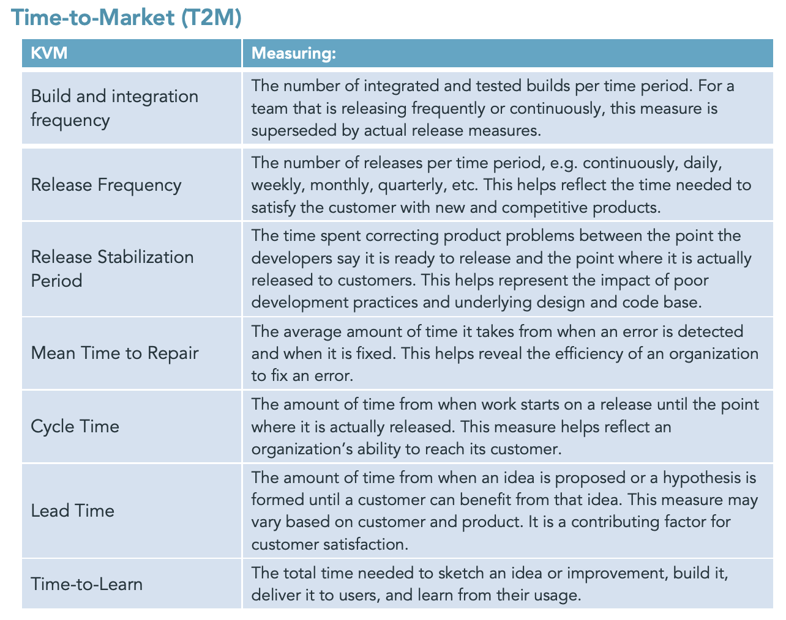
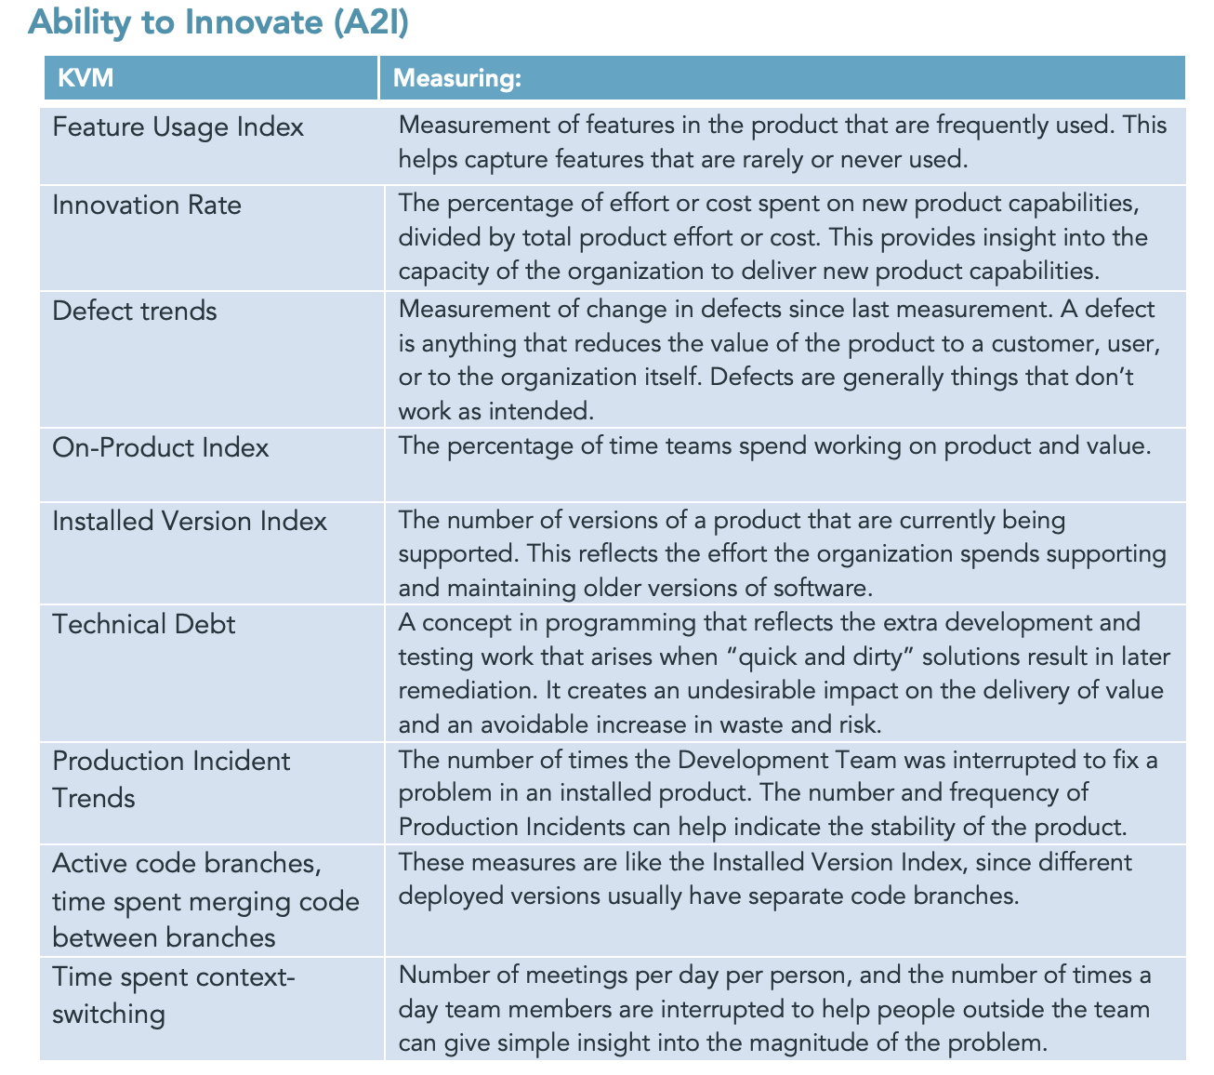
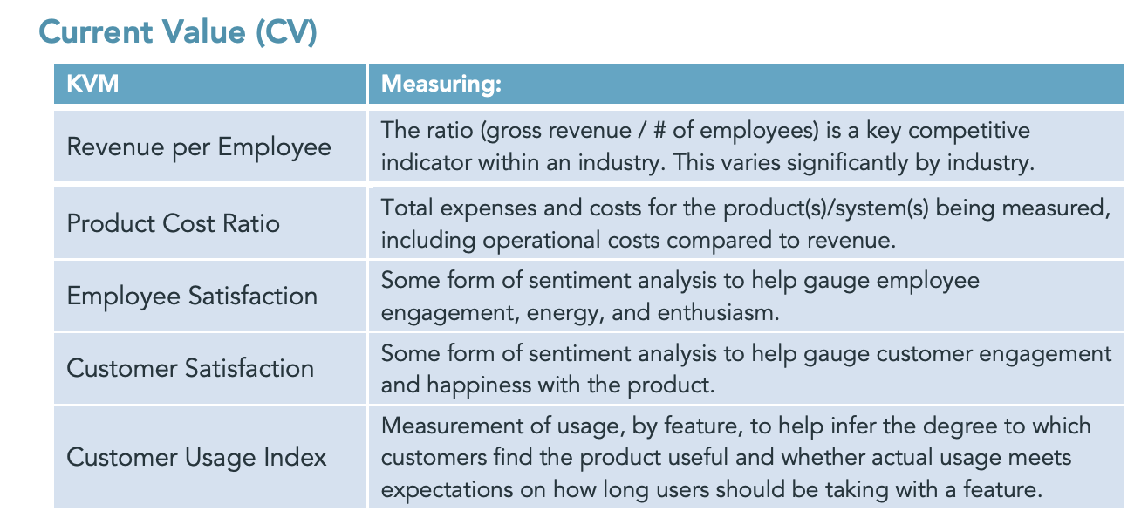
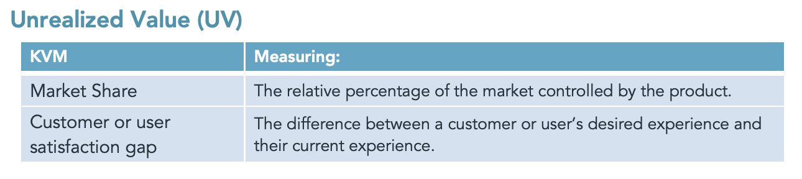
EBM suggested cheat sheet
Source: EBM guide, http://scrum.org/EBM

Slide 64
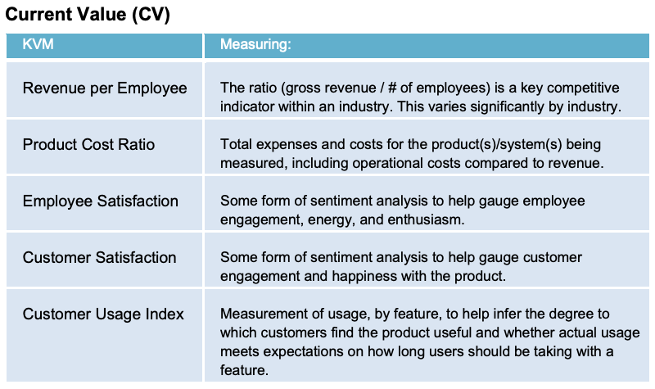
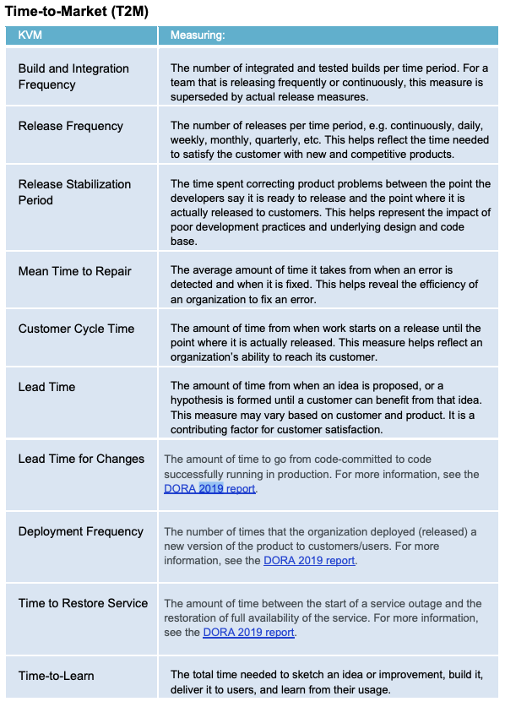
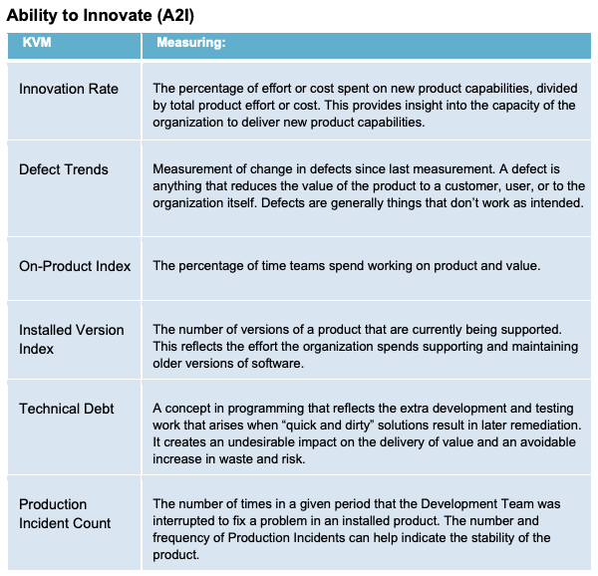
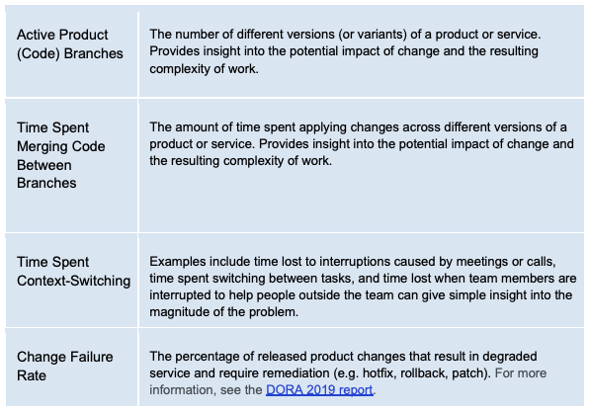
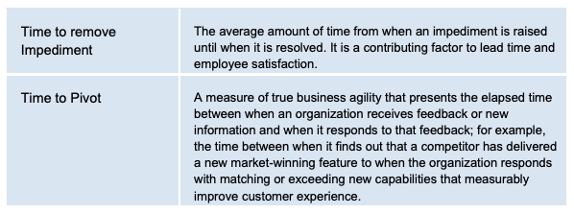
EBM Example Key Value Measures cheat sheet
Source: EBM guide 2020, http://scrum.org/EBM

